Slide 1
Theory Of Computation

Slide 2
Meet Your Presenter
Name: Anshul Shukla
Roll-Number: IC-2K20-12 Course: MCA(5-Years) Semester: 8th Semester Institute: International Institute of Professional Studies, Devi Ahilya University
Grammar Test

Slide 3
Subset of English Grammar
Noun Phrase (NP)
NP → Proper Noun
NP → Article Noun
NP → Article Adjective Noun
Verb Phrase (VP)
VP → Verb
VP → Verb NP
VP → Verb NP PP
Prepositional Phrase (PP)
PP → Preposition NP
Sentence (S)
S → NP VP
S → NP VP PP
Valid Sentences
John runs.
The cat jumps.
The big dog barks.
The cat eats the mouse.
The dog chases the cat.
The book is on the table.
The cat is under the chair.

Slide 4
Question 1:
Use the set of productions to show that each of these sentences is a valid sentence.
the happy hare runs
the sleepy tortoise runs quickly
the tortoise passes the hare
the sleepy hare passes the happy tortoise
a) the happy hare runs
sentence → noun phrase intransitive verb phrase noun phrase
noun phrase → article adjective noun
intransitive verb phrase → intransitive verb
article → the
adjective → happy
noun → hare
intransitive verb → runs
b) the sleepy tortoise runs quickly
sentence → noun phrase intransitive verb phrase noun phrase
noun phrase → article adjective noun
intransitive verb phrase → intransitive verb adverb
article → the
adjective → sleepy
noun → tortoise
intransitive verb → runs
adverb → quickly

Slide 5
Question 1:
Use the set of productions to show that each of these sentences is a valid sentence.
the tortoise passes the hare
the sleepy hare passes the happy tortoise
c) the tortoise passes the hare
sentence → noun phrase transitive verb phrase noun phrase
noun phrase → article noun
transitive verb phrase → transitive verb
article → the
noun → tortoise
transitive verb → passes
noun → hare
d) the sleepy hare passes the happy tortoise
sentence → noun phrase transitive verb phrase noun phrase
noun phrase → article adjective noun
transitive verb phrase → transitive verb
article → the
adjective → sleepy
noun → hare
transitive verb → passes
noun phrase → article adjective noun
article → the
adjective → happy
noun → tortoise

Slide 6
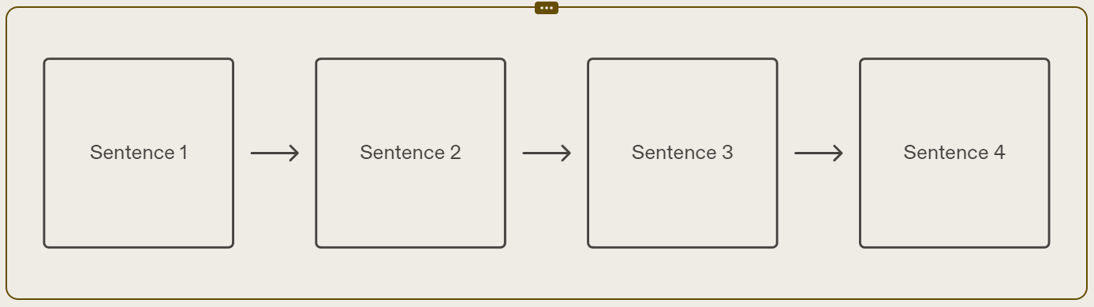
Derivation Trees
Derivation Trees
A derivation tree represents the step-by-step process of generating a sentence in a formal grammar. Each node in the tree corresponds to a production rule in the grammar, and the leaves represent the words in the sentence.
Sentence 1
Explanation of the derivation steps for Sentence 1.
Sentence 2
Explanation of the derivation steps for Sentence 2.
Sentence 3
Explanation of the derivation steps for Sentence 3.
Sentence 4
Explanation of the derivation steps for Sentence 4.

Slide 7
Question 2:
Construct derivation trees for the sentences:
the happy hare runs
Sentence
Noun phrase
Intransitive Verb Phrase
article
adjective
noun
Intransitive Verb
the
happy
hare
runs

Slide 8
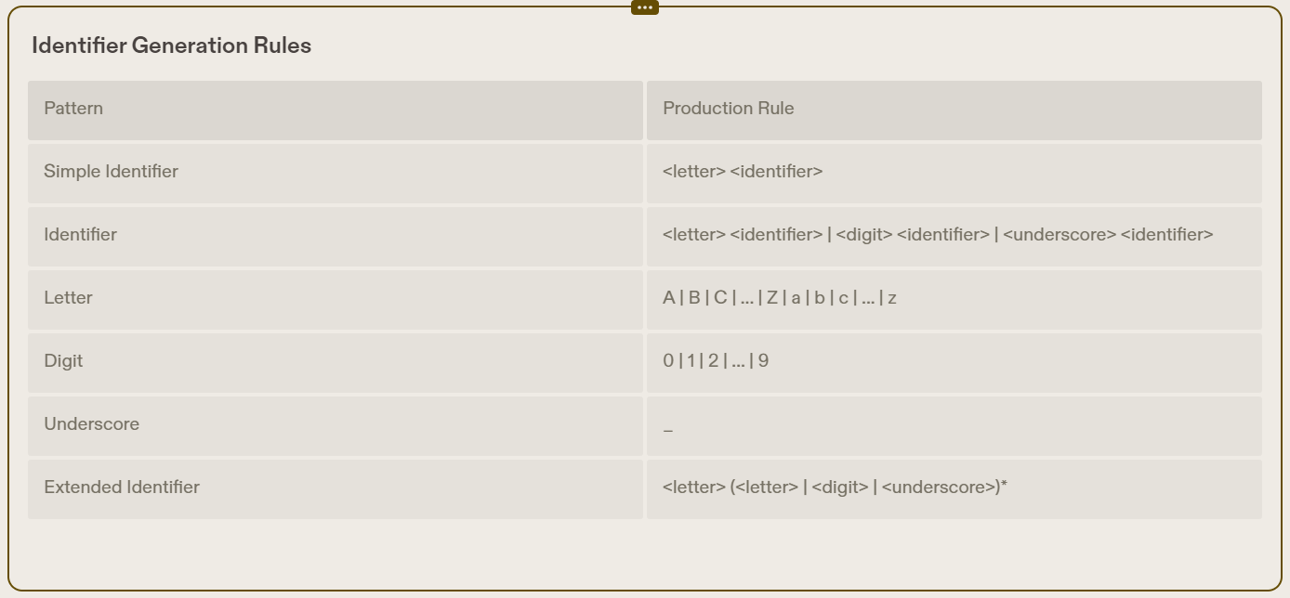
Question 3:
Construct a phrase-structure grammar that generates all signed decimal numbers, consisting of a sign, either + or −; a nonnegative integer; and a decimal fraction that is either the empty string or a decimal point followed by a positive integer, where initial zeros in an integer are allowed.
Phrase-Structure Grammar
A phrase-structure grammar is a formal grammar that describes the structure of a language by defining a set of rules that specify how phrases can be formed from smaller constituents. In the context of signed decimal numbers, we can construct a phrase-structure grammar to define the syntax of these numbers.

Slide 9
Question 3:
Construct a phrase-structure grammar that generates all signed decimal numbers, consisting of a sign, either + or −; a nonnegative integer; and a decimal fraction that is either the empty string or a decimal point followed by a positive integer, where initial zeros in an integer are allowed.
Code Segments
Here are some code segments that illustrate how to implement a phrase-structure grammar for signed decimal numbers:
# Define the grammar rules
grammar = nltk.CFG.fromstring(
S -> Sign Number
Sign -> '+' | '-’
Number -> Integer '.' Integer
Integer -> Digit Integer | Digit
Digit -> '0' | '1' | '2' | '3' | '4' | '5' | '6' | '7' | '8' | '9'
# Create a parser
parser = nltk.ChartParser(grammar)
# Parse a signed decimal number
parse_tree = next(parser.parse(['-', '3', '.', '14'])) print(parse_tree)

Slide 10
Question 3:
Construct a phrase-structure grammar that generates all signed decimal numbers, consisting of a sign, either + or −; a nonnegative integer; and a decimal fraction that is either the empty string or a decimal point followed by a positive integer, where initial zeros in an integer are allowed.
S -> Sign Number
Sign -> '+' | '-’
Number -> Integer '.' Integer
Integer -> Digit Integer | Digit
Digit -> '0' | '1' | '2' | '3' | '4' | '5' | '6' | '7' | '8' | '9'

Slide 11
Question 4:
Provide the Backus-Naur Form (BNF) of a grammar that generates all signed decimal numbers, composed of a sign (either + or −), a nonnegative integer, and a decimal fraction, which can be either an empty string or a decimal point followed by a positive integer, where leading zeros in an integer are permitted.
Syntax:
Consists of a set of production rules.
Each rule defines how symbols can be combined to form valid strings in the language.
Consists of terminal symbols, non-terminal symbols, and production rules.
Usage in Defining Grammars:
BNF provides a concise and formal way to define the structure of a language or grammar.
Used in the specification of programming languages, document formats, and communication protocols.
Provides a foundation for parser generation and language implementation.
Example BNF Rule:
<expression> ::= <term> | <expression> "+" <term> | <expression> "-" <term>

Slide 12
Question 4:
Provide the Backus-Naur Form (BNF) of a grammar that generates all signed decimal numbers, composed of a sign (either + or −), a nonnegative integer, and a decimal fraction, which can be either an empty string or a decimal point followed by a positive integer, where leading zeros in an integer are permitted.
Phrase-Structure Grammar:
signed_decimal → sign nonnegative_integer decimal_fraction
sign → '+' | '-’
nonnegative_integer → digit | digit nonnegative_integer
decimal_fraction → epsilon | '.' positive_integer
positive_integer → digit | digit positive_integer
digit → '0' | '1' | '2' | '3' | '4' | '5' | '6' | '7' | '8' | '9’
epsilon → ε
Backus-Naur Form (BNF):
signed_decimal ::= sign nonnegative_integer decimal_fraction
sign ::= '+' | '-’
nonnegative_integer ::= digit | digit nonnegative_integer
decimal_fraction ::= epsilon | '.' positive_integer
positive_integer ::= digit | digit positive_integer
digit ::= '0' | '1' | '2' | '3' | '4' | '5' | '6' | '7' | '8' | '9’
epsilon ::= ε

Slide 13
Question 5:
Give production rules in Backus–Naur form for an identifier if it can consist of
one or more lowercase letters.
at least three but no more than six lowercase letters.
one to six uppercase or lowercase letters beginning with an uppercase letter.
a lowercase letter, followed by a digit or an under score, followed by three or four alphanumeric characters (lower or uppercase letters and digits)
Syntax:
Consists of a set of production rules.
Each rule defines how symbols can be combined to form valid strings in the language.
Consists of terminal symbols, non-terminal symbols, and production rules.
Usage in Defining Grammars:
BNF provides a concise and formal way to define the structure of a language or grammar.
Used in the specification of programming languages, document formats, and communication protocols.
Provides a foundation for parser generation and language implementation.
Example BNF Rule:
<expression> ::= <term> | <expression> "+" <term> | <expression> "-" <term>

Slide 14
Question 5:
Give production rules in Backus–Naur form for an identifier if it can consist of
one or more lowercase letters.
at least three but no more than six lowercase letters.
one to six uppercase or lowercase letters beginning with an uppercase letter.
a lowercase letter, followed by a digit or an under score, followed by three or four alphanumeric characters (lower or uppercase letters and digits)
⟨identifier⟩ ::= ⟨lcletter⟩ | ⟨identifier⟩ ⟨lcletter⟩ ⟨lcletter⟩ ::= a | b | c | ⋯ | z
⟨identifier⟩ ::= ⟨lcletter⟩⟨lcletter⟩⟨lcletter⟩ | ⟨lcletter⟩⟨lcletter⟩⟨lcletter⟩⟨lcletter⟩ | ⟨lcletter⟩⟨lcletter⟩⟨lcletter⟩⟨lcletter⟩⟨lcletter⟩ | ⟨lcletter⟩⟨lcletter⟩⟨lcletter⟩⟨lcletter⟩⟨lcletter⟩⟨lcletter⟩ ⟨lcletter⟩ ::= a | b | c | ⋯ | z

Slide 15
Question 5:
Give production rules in Backus–Naur form for an identifier if it can consist of
one or more lowercase letters.
at least three but no more than six lowercase letters.
one to six uppercase or lowercase letters beginning with an uppercase letter.
a lowercase letter, followed by a digit or an under score, followed by three or four alphanumeric characters (lower or uppercase letters and digits)
⟨identifier⟩ ::= ⟨ucletter⟩ |
⟨ucletter⟩⟨letter⟩ |
⟨ucletter⟩⟨letter⟩⟨letter⟩ |
⟨ucletter⟩⟨letter⟩⟨letter⟩⟨letter⟩ |
⟨ucletter⟩⟨letter⟩⟨letter⟩⟨letter⟩⟨letter⟩ |
⟨ucletter⟩⟨letter⟩⟨letter⟩⟨letter⟩⟨letter⟩⟨letter⟩
⟨letter⟩ ::= ⟨lcletter⟩ | ⟨ucletter⟩
⟨lcletter⟩ ::= a | b | c | ⋯ | z
⟨ucletter⟩ ::= A | B | C | ⋯ | Z

Slide 16
Question 5:
Give production rules in Backus–Naur form for an identifier if it can consist of
one or more lowercase letters.
at least three but no more than six lowercase letters.
one to six uppercase or lowercase letters beginning with an uppercase letter.
a lowercase letter, followed by a digit or an under score, followed by three or four alphanumeric characters (lower or uppercase letters and digits)
⟨identifier⟩ ::= ⟨lcletter⟩⟨digitorus⟩⟨alphanumeric⟩⟨alphanumeric⟩⟨alphanumeric⟩ | ⟨lcletter⟩⟨digitorus⟩⟨alphanumeric⟩⟨alphanumeric⟩⟨alphanumeric⟩⟨alphanumeric⟩
⟨digitorus⟩ ::= ⟨digit⟩ | ⟨underscore⟩
⟨alphanumeric⟩ ::= ⟨letter⟩ | ⟨digit⟩
⟨letter⟩ ::= ⟨lcletter⟩ | ⟨ucletter⟩
⟨lcletter⟩ ::= a | b | c | ⋯ | z
⟨ucletter⟩ ::= A | B | C | ⋯ | Z
⟨digit⟩ ::= 0 | 1 | 2 | ⋯ | 9
⟨underscore⟩ ::= _

Slide 17
Question 6:
Give production rules in Backus–Naur form that generates all identifiers in the C programming language. In Can identifier starts with a letter or an underscore ( ) that is followed by one or more lowercase letters, uppercase letters, underscores, and digits.
⟨identifier⟩ ::= ⟨letterorus⟩ ∣ ⟨identifier⟩⟨symbol⟩
⟨letterorus⟩ ::= ⟨letter⟩ ∣
⟨symbol⟩ ::= ⟨letterorus⟩ ∣ ⟨digit⟩
⟨letter⟩ ::= ⟨lcletter⟩ ∣ ⟨ucletter⟩
⟨lcletter⟩ ::= a ∣ b ∣ c ∣ ⋯ ∣ z
⟨ucletter⟩ ::= A ∣ B ∣ C ∣ ⋯ ∣ Z
⟨digit⟩ ::= 0 ∣ 1 ∣ 2 ∣ ⋯ ∣ 9

Slide 18
Extended Backus–Naur Form (EBNF)
Production Rules:
The ? metacharacter represents an optional element. It indicates that the preceding element can occur zero or one time.
The * metacharacter represents a repetition. It indicates that the preceding element can occur zero or more times.
The + metacharacter represents a repetition. It indicates that the preceding element must occur one or more times.
Examples:
Optional Element: The production rule A ::= B ? C indicates that element B is optional. It can occur zero or one time in the production.
Repetition: The production rule A ::= B * C indicates that element B can occur zero or more times in the production.
Repetition: The production rule A ::= B + C indicates that element B must occur one or more times in the production.

Slide 19
Question 7:
Give production rules in extended Backus–Naur form that generate all decimal numerals consisting of an optional sign, a nonnegative integer, and a decimal fraction that is either the empty string or a decimal point followed by an optional positive integer optionally preceded by some number of zeros
Give production rules in extended Backus–Naur form for identifiers in the C programming language
numeral ::= sign? nonzerodigit digit∗ decimal? ∣ sign? 0 decimal?
sign ::= + ∣ −
nonzerodigit ::= 1 ∣ 2 ∣ ⋯ ∣ 9
digit ::= 0 ∣ nonzerodigit
decimal ::= .digit∗
identifier ::= letterorus symbol ∗
letterorus ::= letter ∣
symbol ::= letterorus ∣ digit
letter ::= lcletter ∣ ucletter
lcletter ::= a ∣ b ∣ c ∣ ⋯ ∣ z
ucletter ::= A ∣ B ∣ C ∣ ⋯ ∣ Z
digit ::= 0 ∣ 1 ∣ 2 ∣ ⋯ ∣ 9

Slide 20
Question 8:
Use Backus–Naur form to describe the syntax of expressions in infix notation, where the set of operators and identifiers is the same as in the BNF for postfix expressions, but parentheses must surround expressions being used as factors.
For each of these strings, determine whether it is generated by the grammar for infix expressions by it or not. If it is, find the steps used to generate the string.
x + y + z
a∕b + c∕d
m ∗ (n + p) d) + m − n + p − q
(m + n) ∗ (p − q)
x + y + z
Not generated
(m + n) ∗ (p − q)
⟨expression⟩
⟨term⟩
⟨factor⟩⟨mulOperator⟩⟨factor⟩
(⟨expression⟩)⟨mulOperator⟩(⟨expression⟩)
(⟨term⟩⟨addOperator⟩⟨term⟩)⟨mulOperator⟩(⟨term⟩⟨addOperator⟩⟨term⟩)
(⟨factor⟩⟨addOperator⟩⟨factor⟩)⟨mulOperator⟩(⟨factor⟩⟨addOperator⟩⟨factor⟩)
(⟨identifier⟩⟨addOperator⟩⟨identifier⟩)⟨mulOperator⟩(⟨identifier⟩⟨addOperator⟩
⟨identifier⟩)

Slide 21
Question 8:
Use Backus–Naur form to describe the syntax of expressions in infix notation, where the set of operators and identifiers is the same as in the BNF for postfix expressions, but parentheses must surround expressions being used as factors.
For each of these strings, determine whether it is generated by the grammar for infix expressions by it or not. If it is, find the steps used to generate the string.
x + y + z
a∕b + c∕d
m ∗ (n + p) d) + m − n + p − q
(m + n) ∗ (p − q)
m ∗ (n + p) d) + m − n + p − q
⟨expression⟩
⟨term⟩
⟨factor⟩⟨mulOperator⟩⟨factor⟩
⟨factor⟩⟨mulOperator⟩(⟨expression⟩)
⟨factor⟩⟨mulOperator⟩(⟨term⟩⟨addOperator⟩⟨term⟩)
⟨factor⟩⟨mulOperator⟩(⟨factor⟩⟨addOperator⟩⟨factor⟩)
⟨identifier⟩⟨mulOperator⟩(⟨identifier⟩⟨addOperator⟩⟨identifier⟩)

Slide 22
Question 8:
Use Backus–Naur form to describe the syntax of expressions in infix notation, where the set of operators and identifiers is the same as in the BNF for postfix expressions, but parentheses must surround expressions being used as factors.
For each of these strings, determine whether it is generated by the grammar for infix expressions by it or not. If it is, find the steps used to generate the string.
x + y + z
a∕b + c∕d
m ∗ (n + p) d) + m − n + p − q
(m + n) ∗ (p − q)
a∕b + c∕d
⟨expression⟩
⟨term⟩⟨addOperator⟩⟨term⟩
⟨factor⟩⟨mulOperator⟩⟨factor⟩⟨addOperator⟩⟨factor⟩⟨mulOperator⟩⟨factor⟩
⟨identifier⟩⟨mulOperator⟩⟨identifier⟩⟨addOperator⟩⟨identifier⟩⟨mulOperator⟩⟨identifier⟩

Slide 23
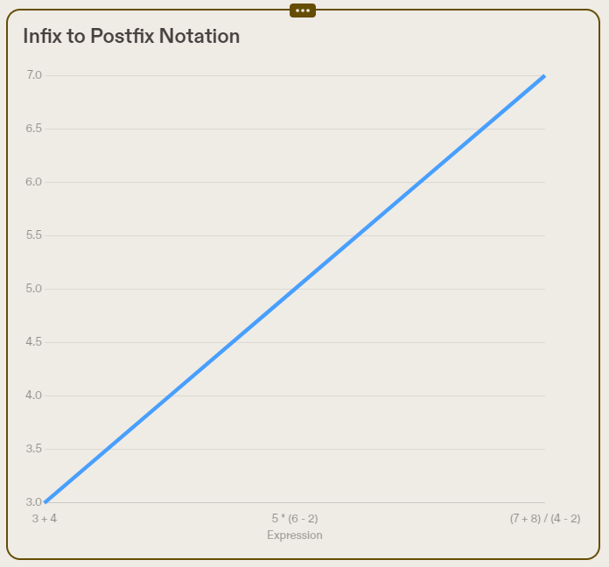
Postfix Notation:
Infix notation is the commonly used arithmetic or logical formula notation. In this notation, operators are written between operands. For example, the infix expression '3 + 4' has the operator '+' between the operands 3 and 4. However, in postfix notation, operators are written after the operands. For the same expression, the postfix notation would be '3 4 +'.
Infix Notation
Infix notation is a common way of writing arithmetic expressions where the operators are placed between the operands. For example, the infix notation for the expression '2 + 3' is '2 + 3'. Infix notation is widely used in mathematics and programming languages.
In contrast to infix notation, there are other notations such as prefix notation (also known as Polish notation) and postfix notation (also known as Reverse Polish notation). These notations have different rules for placing operators and operands, and they are often used in stack-based algorithms and calculators.

Slide 24
Question 9:
For each of these strings, determine whether it is generated by the grammar given for postfix notation. If it is,find the steps used to generate the string
abc∗+
xy++
xy−z∗
wxyz−∗∕
ade−∗
abc∗+
⟨expression⟩
⟨term⟩⟨term⟩⟨addOperator⟩
⟨factor⟩⟨factor⟩⟨factor⟩⟨mulOperator⟩⟨addOperator⟩
⟨identifier⟩⟨identifier⟩⟨identifier⟩⟨mulOperator⟩⟨addOperator⟩
xy++
Not generated

Slide 25
Question 9:
For each of these strings, determine whether it is generated by the grammar given for postfix notation. If it is,find the steps used to generate the string
abc∗+
xy++
xy−z∗
wxyz−∗∕
ade−∗
xy−z∗
⟨expression⟩
⟨term⟩
⟨factor⟩⟨factor⟩⟨mulOperator⟩
⟨expression⟩⟨factor⟩⟨mulOperator⟩
⟨term⟩⟨term⟩⟨addOperator⟩⟨factor⟩⟨mulOperator⟩
⟨factor⟩⟨factor⟩⟨addOperator⟩⟨factor⟩⟨mulOperator⟩
⟨identifier⟩⟨identifier⟩⟨addOperator⟩⟨identifier⟩⟨mulOperator⟩

Slide 26
Question 9:
For each of these strings, determine whether it is generated by the grammar given for postfix notation. If it is,find the steps used to generate the string
abc∗+
xy++
xy−z∗
wxyz−∗∕
ade−∗
wxyz−∗∕
⟨expression⟩
⟨term⟩
⟨factor⟩⟨factor⟩⟨mulOperator⟩
⟨factor⟩⟨expression⟩⟨mulOperator⟩
⟨factor⟩⟨term⟩⟨mulOperator⟩
⟨factor⟩⟨factor⟩⟨factor⟩⟨mulOperator⟩⟨mulOperator⟩
⟨factor⟩⟨factor⟩⟨expression⟩⟨mulOperator⟩⟨mulOperator⟩
⟨factor⟩⟨factor⟩⟨term⟩⟨term⟩⟨addOperator⟩⟨mulOperator⟩⟨mulOperator⟩
⟨factor⟩⟨factor⟩⟨factor⟩⟨factor⟩⟨addOperator⟩⟨mulOperator⟩⟨mulOperator⟩
⟨identifier⟩⟨identifier⟩⟨identifier⟩⟨identifier⟩⟨addOperator⟩⟨mulOperator⟩⟨mulOperator⟩

Slide 27
Question 9:
For each of these strings, determine whether it is generated by the grammar given for postfix notation. If it is,find the steps used to generate the string
abc∗+
xy++
xy−z∗
wxyz−∗∕
ade−∗
ade−∗
⟨expression⟩
⟨term⟩
⟨factor⟩⟨factor⟩⟨mulOperator⟩
⟨factor⟩⟨expression⟩⟨mulOperator⟩
⟨factor⟩⟨term⟩⟨term⟩⟨addOperator⟩⟨mulOperator⟩
⟨factor⟩⟨factor⟩⟨factor⟩⟨addOperator⟩⟨mulOperator⟩
⟨identifier⟩⟨identifier⟩⟨identifier⟩⟨addOperator⟩⟨mulOperator⟩

Slide 28
Conclusion and Summary
Key Takeaways:
We have explored the grammar rules and language generation process presented in the context of formal language theory.
Understanding Backus–Naur Form (BNF) and Extended Backus–Naur Form (EBNF) is crucial for defining grammar rules effectively.
Derivation trees serve as valuable tools for representing language derivations and understanding the structure of generated sentences.
Phrase-structure grammar plays a significant role in generating structured expressions, enabling precise communication and language design.
Final Thoughts:
Formal language theory provides a foundational framework for understanding language structures and syntax, contributing to advancements in linguistics and computer science.
Mastery of grammar rules empowers us to communicate effectively and design efficient programming languages.
Continued exploration and application of formal language theory are essential for driving innovation and progress in various fields.

